Slide 1
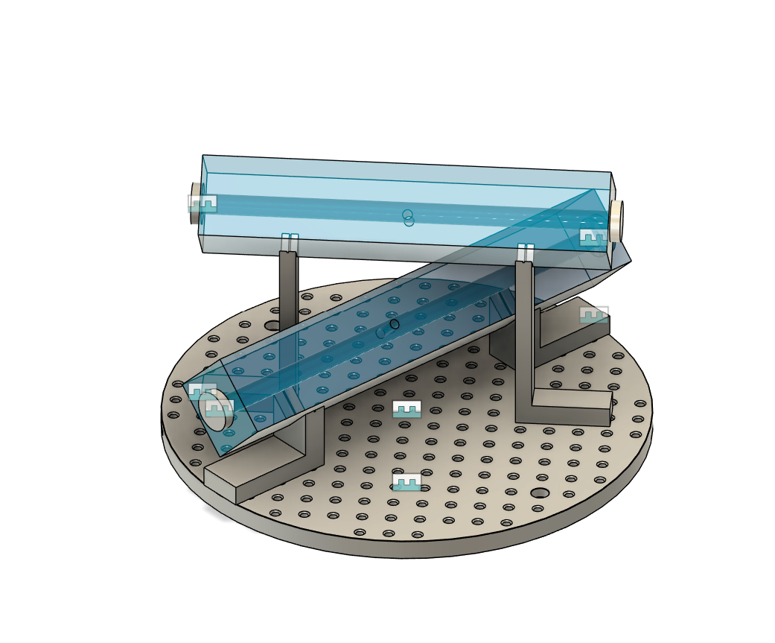
Cavities
No answer from Layertec regarding the mirrors – seems the point of contact is away still

Slide 2
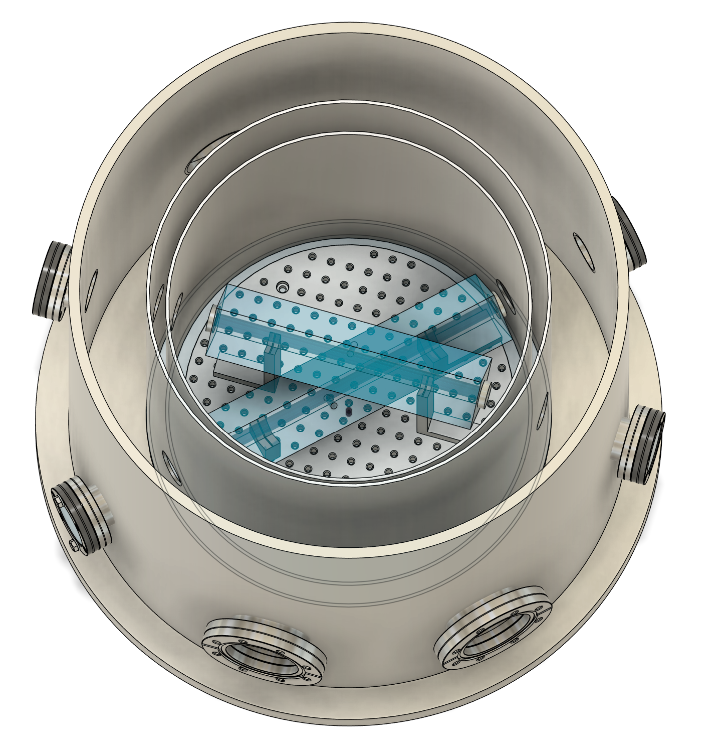
Vacuum and Thermal
Philip can design the shields, he already did it for Hexagon.
Sent him input from my side, I’m yet to receive anything back
I’m unsure about a suitable beam height
Pfeiffer and Allectra also have not responded.

Slide 3
Follow-up Meeting with Michaela
The table should be in the lab before the safety wall
Thorlabs lists a availability as 1 week for the table and legs (probably not true)
The safety wall will presumably take months
It probably makes most sense to do a deeper clean in the lab after the safety wall is installed?
Udo is yet to answer my email

Slide 4
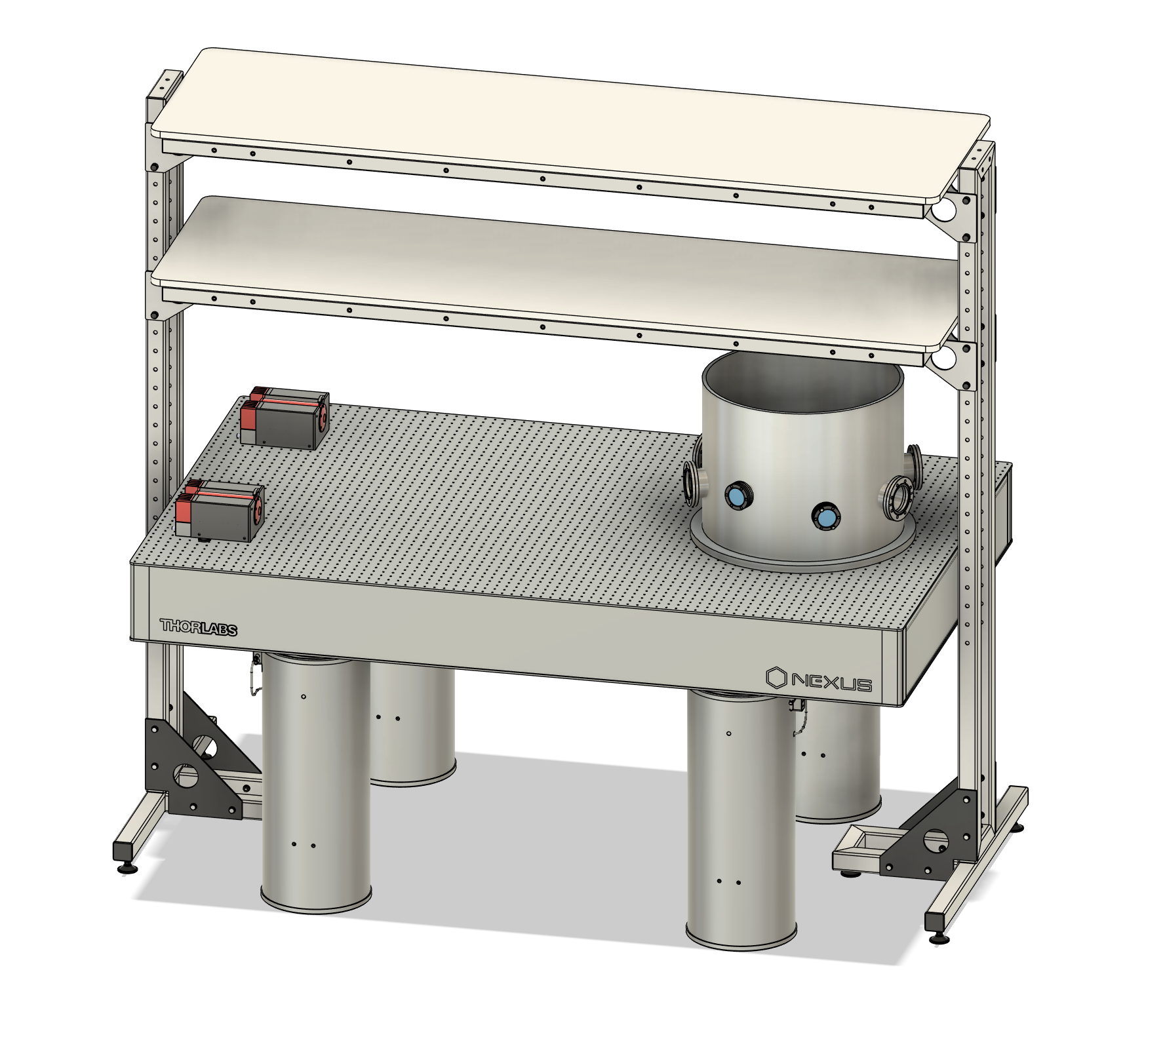
About the Table
Thorlabs has a compatible stand alone shelf for the optical table (about 2 m high)
The full price would be 4443.07 + 3590.81 + 2299.26 = 10333.14 < 15000

